Slide 1
MS WORD
A TO Z Shortcut Keys

Slide 2
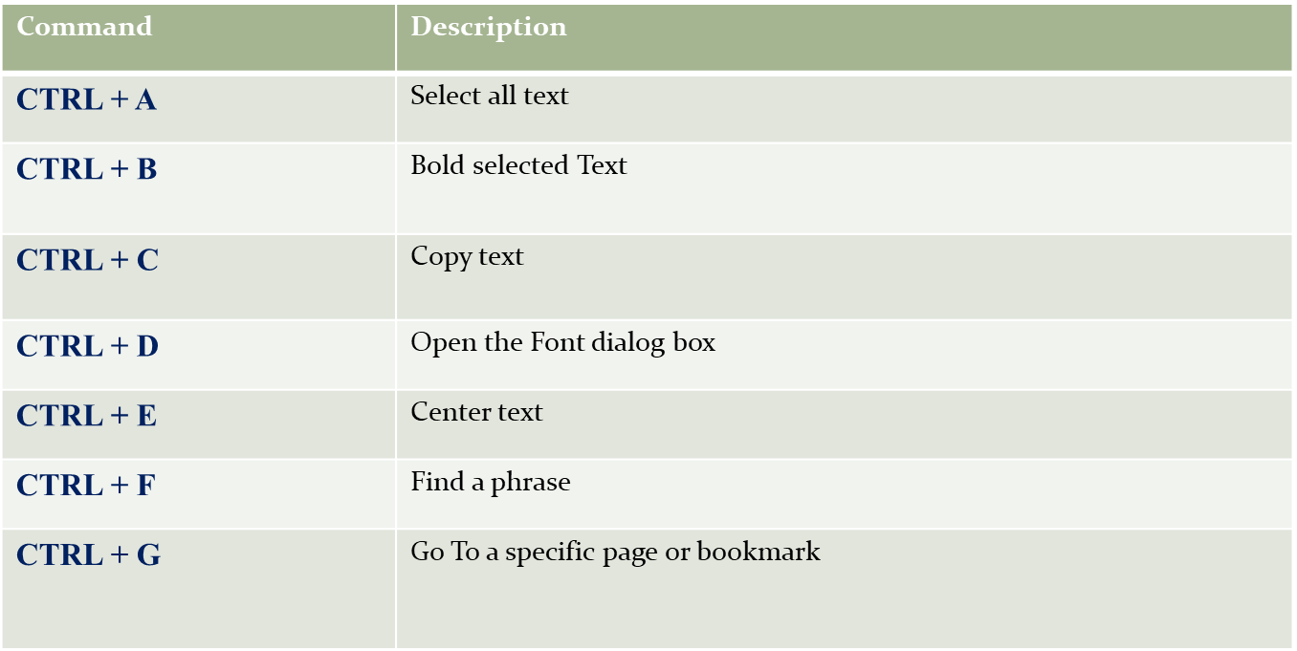

Slide 3
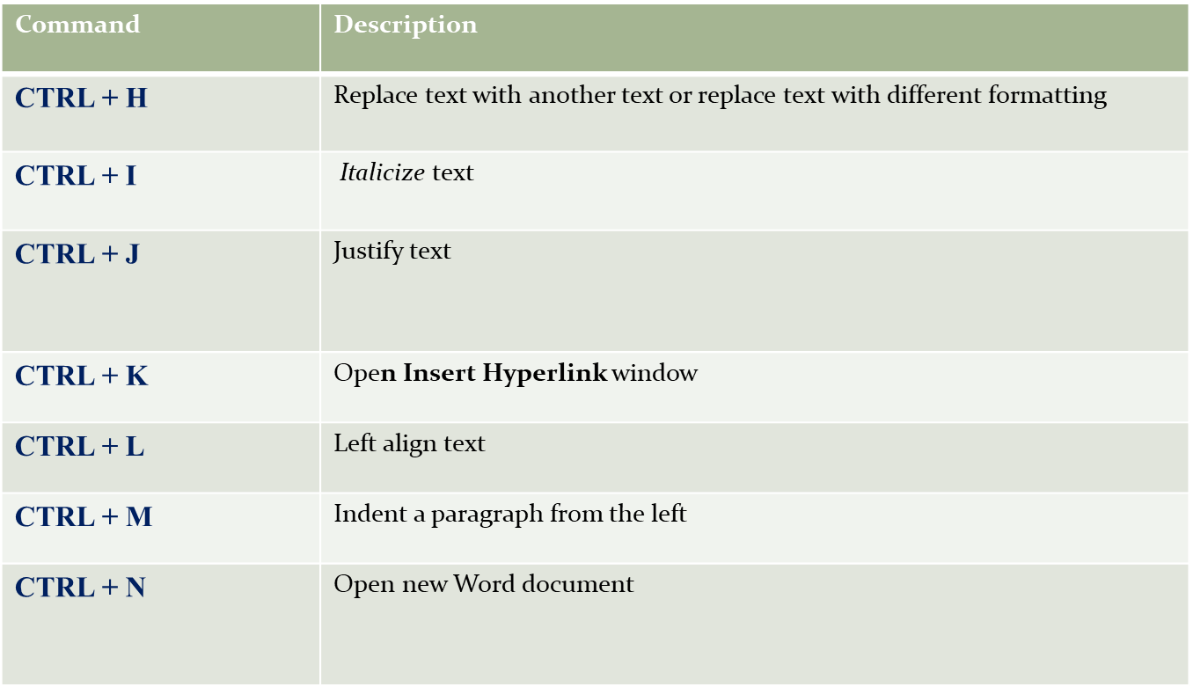

Slide 4
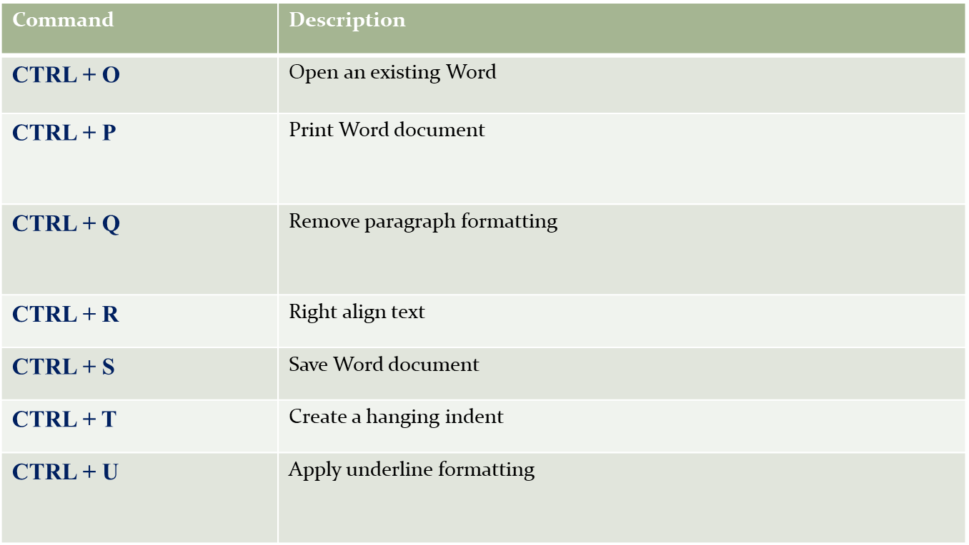

Slide 5
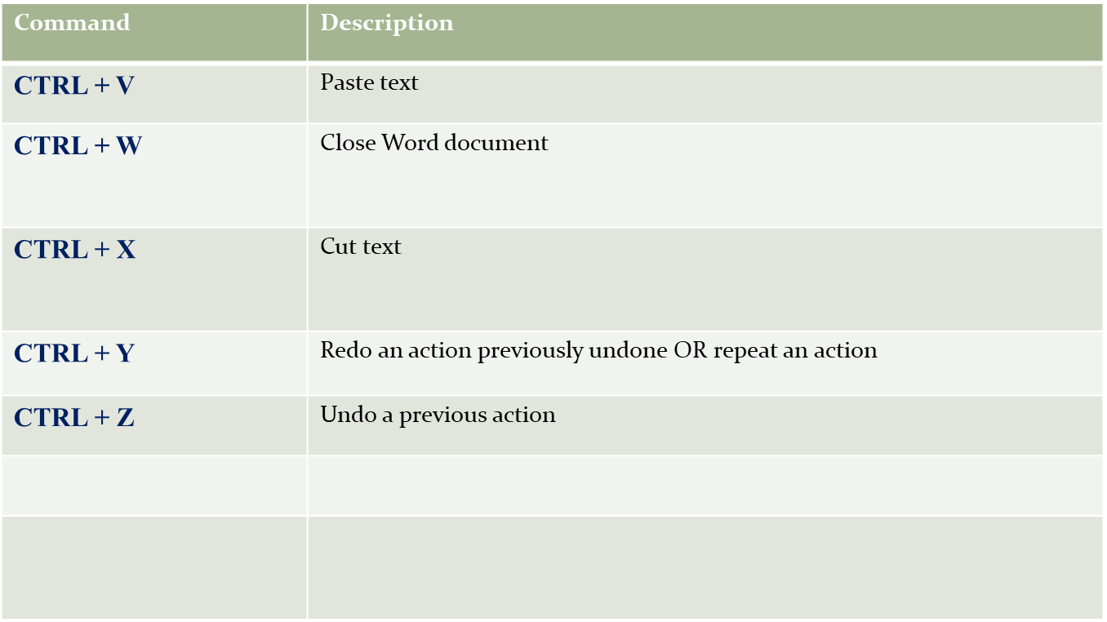

Slide 6
Thank you

